Slide 1
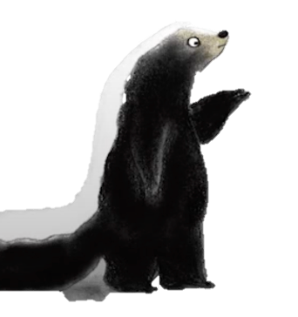
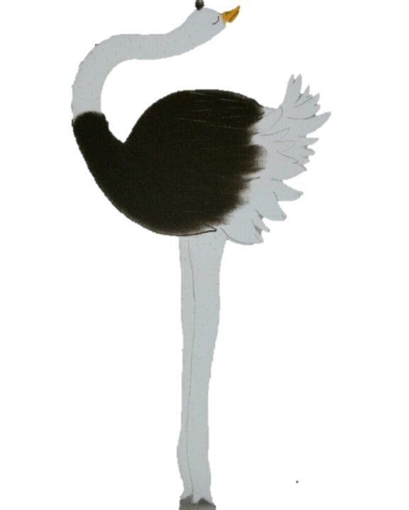
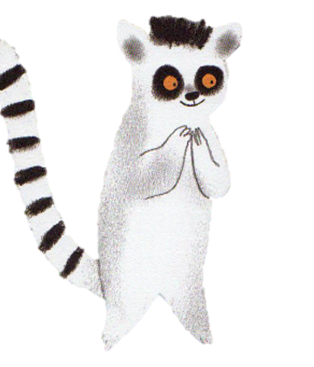
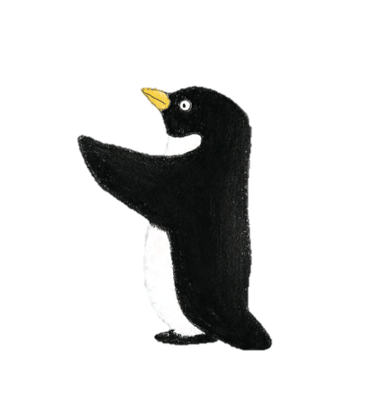
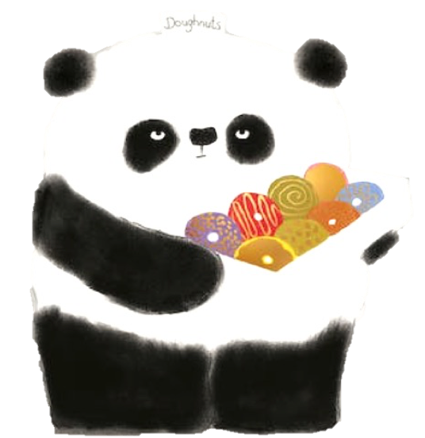
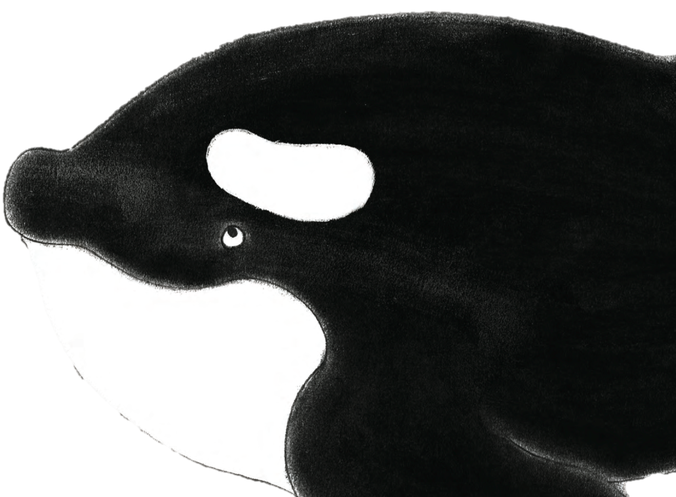
Lemur
Skunk
Ostrich
Panda
Killer Whale
Penguin
[lemur, skunk, ostrich, panda, killer whale, penguin] Antony, S. (2017). Please, Mr. Panda. New York, Cartwheel Books.

Slide 2

Lemur
Skunk
Ostrich
Panda
Killer Whale
Penguin
[lemur, skunk, ostrich, panda, killer whale, penguin] Antony, S. (2017). Please, Mr. Panda. New York, Cartwheel Books.

Slide 3
Lemur
Skunk
Ostrich
Panda
Killer Whale
Penguin
[lemur, skunk, ostrich, panda, killer whale, penguin] Antony, S. (2017). Please, Mr. Panda. New York, Cartwheel Books.

Slide 4
Lemur
Skunk
Ostrich
Panda
Killer Whale
Penguin
[lemur, skunk, ostrich, panda, killer whale, penguin] Antony, S. (2017). Please, Mr. Panda. New York, Cartwheel Books.

Slide 5
Lemur
Skunk
Ostrich
Panda
Killer Whale
Penguin
[lemur, skunk, ostrich, panda, killer whale, penguin] Antony, S. (2017). Please, Mr. Panda. New York, Cartwheel Books.

Slide 6
Lemur
Skunk
Ostrich
Panda
Killer Whale
Penguin
[lemur, skunk, ostrich, panda, killer whale, penguin] Antony, S. (2017). Please, Mr. Panda. New York, Cartwheel Books.

Slide 7
Lemur
Skunk
Ostrich
Panda
Killer Whale
Penguin
[lemur, skunk, ostrich, panda, killer whale, penguin] Antony, S. (2017). Please, Mr. Panda. New York, Cartwheel Books.

Slide 8
Antony, S. (2017). Please, Mr. Panda. New York, Cartwheel Books.

Slide 9

What is the name of this animal?
It is a __ __ __guin.
pen
[penguin] Antony, S. (2017). Please, Mr. Panda. New York, Cartwheel Books.

Slide 10
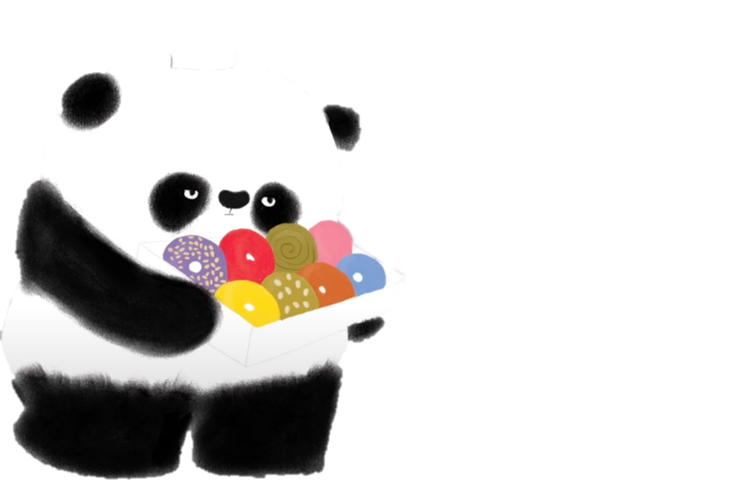
[panda] Antony, S. (2017). Please, Mr. Panda. New York, Cartwheel Books.
Do you think Mr. Panda is going to give the penguin the doughnut?

Slide 11
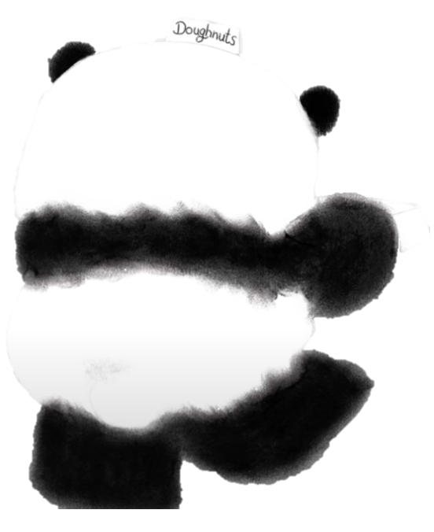
What does change my mind mean?
What did the penguin do wrong?
How can the penguin get the doughnut?
[panda, penguin] Antony, S. (2017). Please, Mr. Panda. New York, Cartwheel Books.

Slide 12
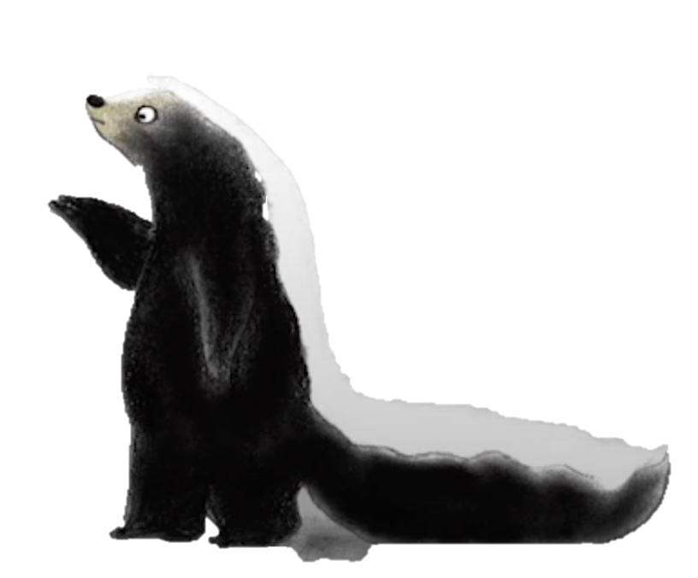
What is the name of this animal?
It is a sk__ __ _.
unk
[skunk] Antony, S. (2017). Please, Mr. Panda. New York, Cartwheel Books.

Slide 13
[panda] Antony, S. (2017). Please, Mr. Panda. New York, Cartwheel Books.
Do you think Mr. Panda is going to give the skunk the doughnut?

Slide 14
What did the skunk do wrong?
What can the skunk say to get the doughnut?
[skunk, panda] Antony, S. (2017). Please, Mr. Panda. New York, Cartwheel Books.

Slide 15
What is the name of this animal?
It is an ost$$$$.
ostrich.
[ostrich] Antony, S. (2017). Please, Mr. Panda. New York, Cartwheel Books.

Slide 16
[ostrich, panda] Antony, S. (2017). Please, Mr. Panda. New York, Cartwheel Books.
Why was the ostrich’s answer not polite?
Do you think Mr. Panda feels happy or sad? Why?
What is a polite way to get the doughnut?

Slide 17
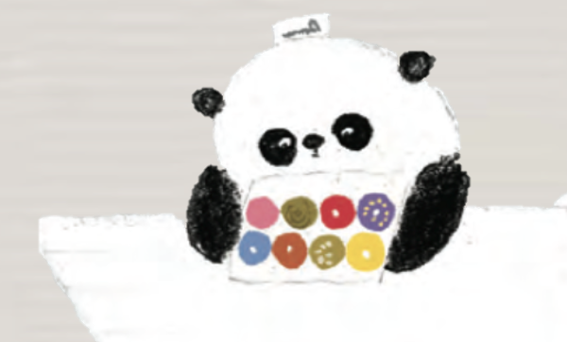
[panda, killer whale] Antony, S. (2017). Please, Mr. Panda. New York, Cartwheel Books.
What is the name of this animal?
It is a killer w_a_e.
h l

Slide 18
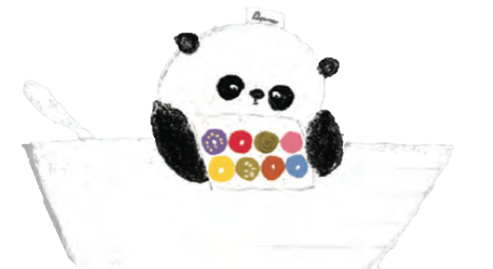
Do you think Mr. Panda is going to give the killer whale the doughnut?
[panda] Antony, S. (2017). Please, Mr. Panda. New York, Cartwheel Books.

Slide 19
What did the killer whale do wrong?
How many doughnuts does the killer whale want?
What is a better way to ask for the doughnut?
[panda, killer whale] Antony, S. (2017). Please, Mr. Panda. New York, Cartwheel Books.

Slide 20
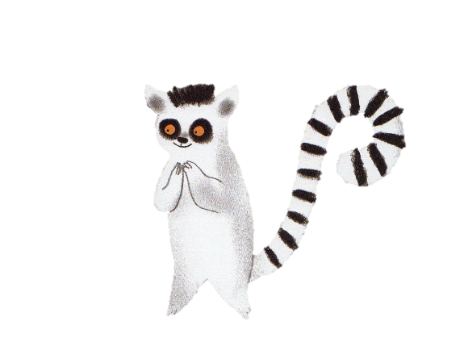
What is the name of this animal?
It is a l_m_r.
e u
[lemur] Antony, S. (2017). Please, Mr. Panda. New York, Cartwheel Books.

Slide 21
[panda] Antony, S. (2017). Please, Mr. Panda. New York, Cartwheel Books.
Do you think Mr. Panda is going to give the lemur the doughnut?
What words does the lemur say?

Slide 22
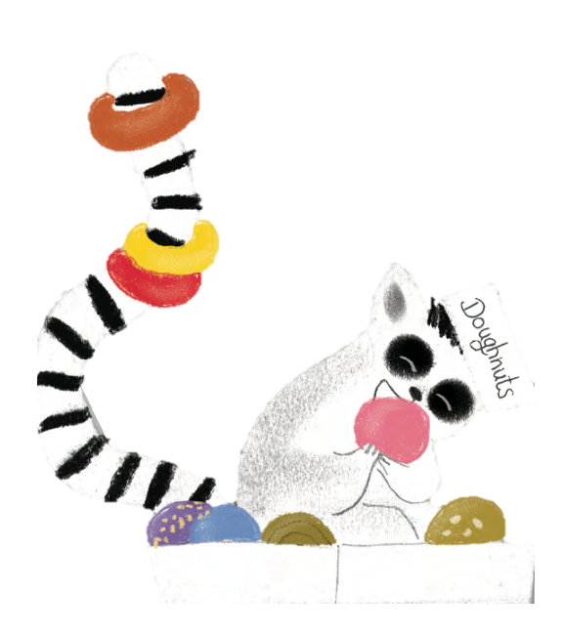
Why did Mr. Panda give all of the doughnuts to the lemur?
What did the lemur do right?
[lemur, panda] Antony, S. (2017). Please, Mr. Panda. New York, Cartwheel Books.

Slide 23
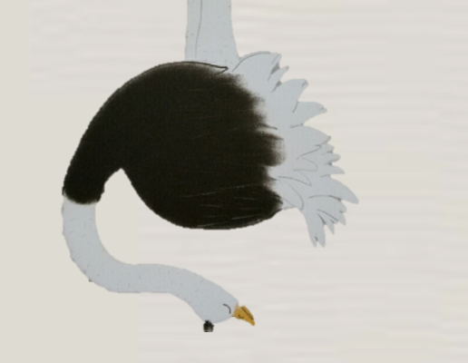
Activity
1
[lemur, skunk, ostrich, panda, killer whale, penguin] Antony, S. (2017). Please, Mr. Panda. New York, Cartwheel Books.

Slide 24


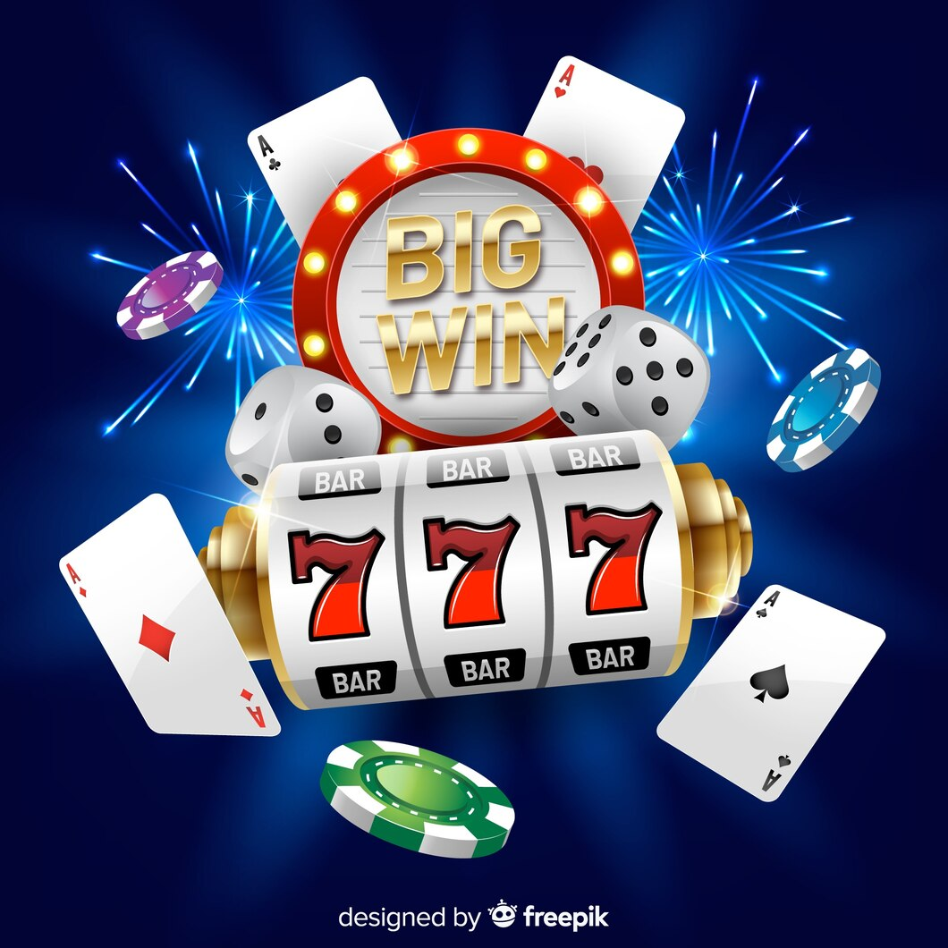

Bet questions.
Answer the questions correctly to get points.
Raise your hand.
Come to the board.
Link to activity
Instructions
[penguin] Antony, S. (2017). Please, Mr. Panda. New York, Cartwheel Books.
Notes:
<a href="https://www.freepik.com/free-vector/slot-machine-big-win-concept-realistic-style_4471699.htm#query=jackpot&position=7&from_view=search&track=sph&uuid=7a97ca80-bcd6-4955-9f0f-ffed5bec0400">Image by pikisuperstar</a> on Freepik

Slide 25

Bonus Round
Bet 0 to all of your points!
Notes:
<a href="https://www.freepik.com/free-vector/ribbon-cutting-ceremony-poster-with-red-curtains-vector-illustration_16305272.htm#query=bet&position=20&from_view=search&track=sph&uuid=ca2aa91b-944f-48ef-ad5f-13b84ab3c371">Image by nuraghies</a> on Freepik

Slide 26
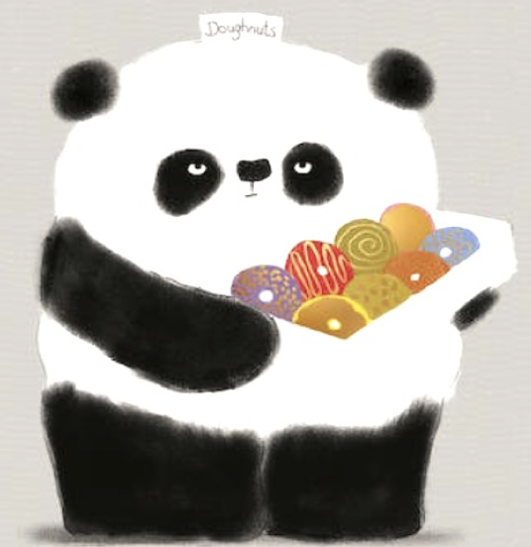
What is another way to spell doughnut?
Donut
[panda] Antony, S. (2017). Please, Mr. Panda. New York, Cartwheel Books.

Slide 27
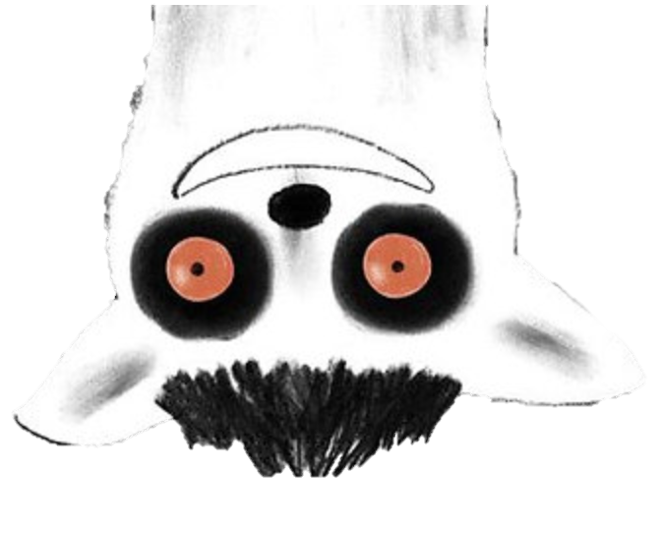
Activity 2
[lemur, ostrich, killer whale, penguin] Antony, S. (2017). Please, Mr. Panda. New York, Cartwheel Books.

Slide 28

my I changed mind have.
I have my changed mind.
[skunk, panda] Antony, S. (2017). Please, Mr. Panda. New York, Cartwheel Books.

Slide 29
Raise your hand.
Come to the board.
Put the sentences in order.
Say the sentences out loud.
Link to activity
Instructions
[lemur, panda, penguin] Antony, S. (2017). Please, Mr. Panda. New York, Cartwheel Books.

