Slide 1
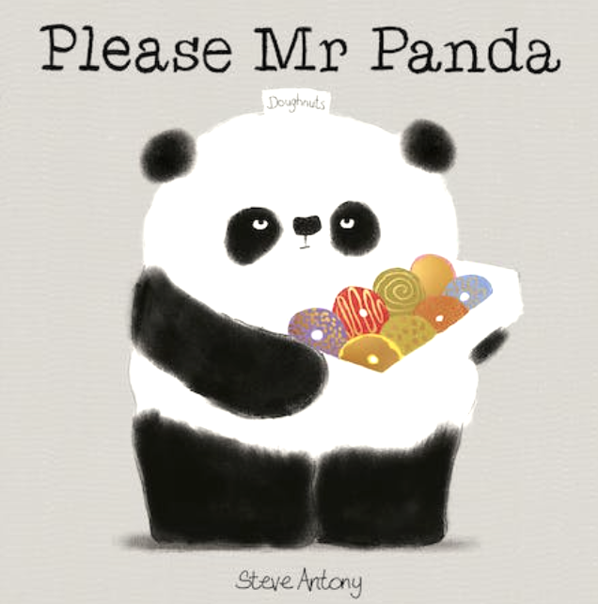
Antony, S. (2017). Please, Mr. Panda. New York, Cartwheel Books.

Slide 2
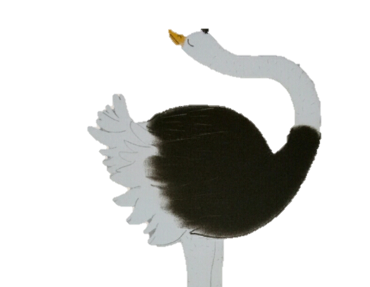
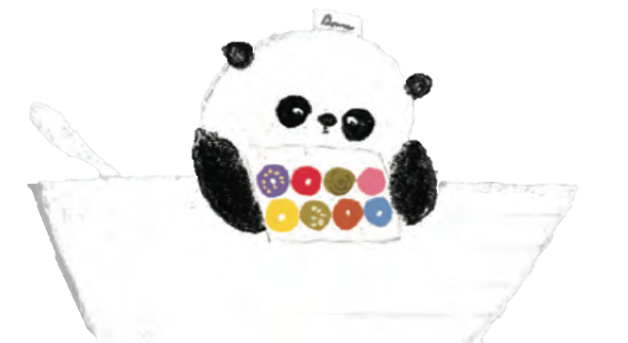
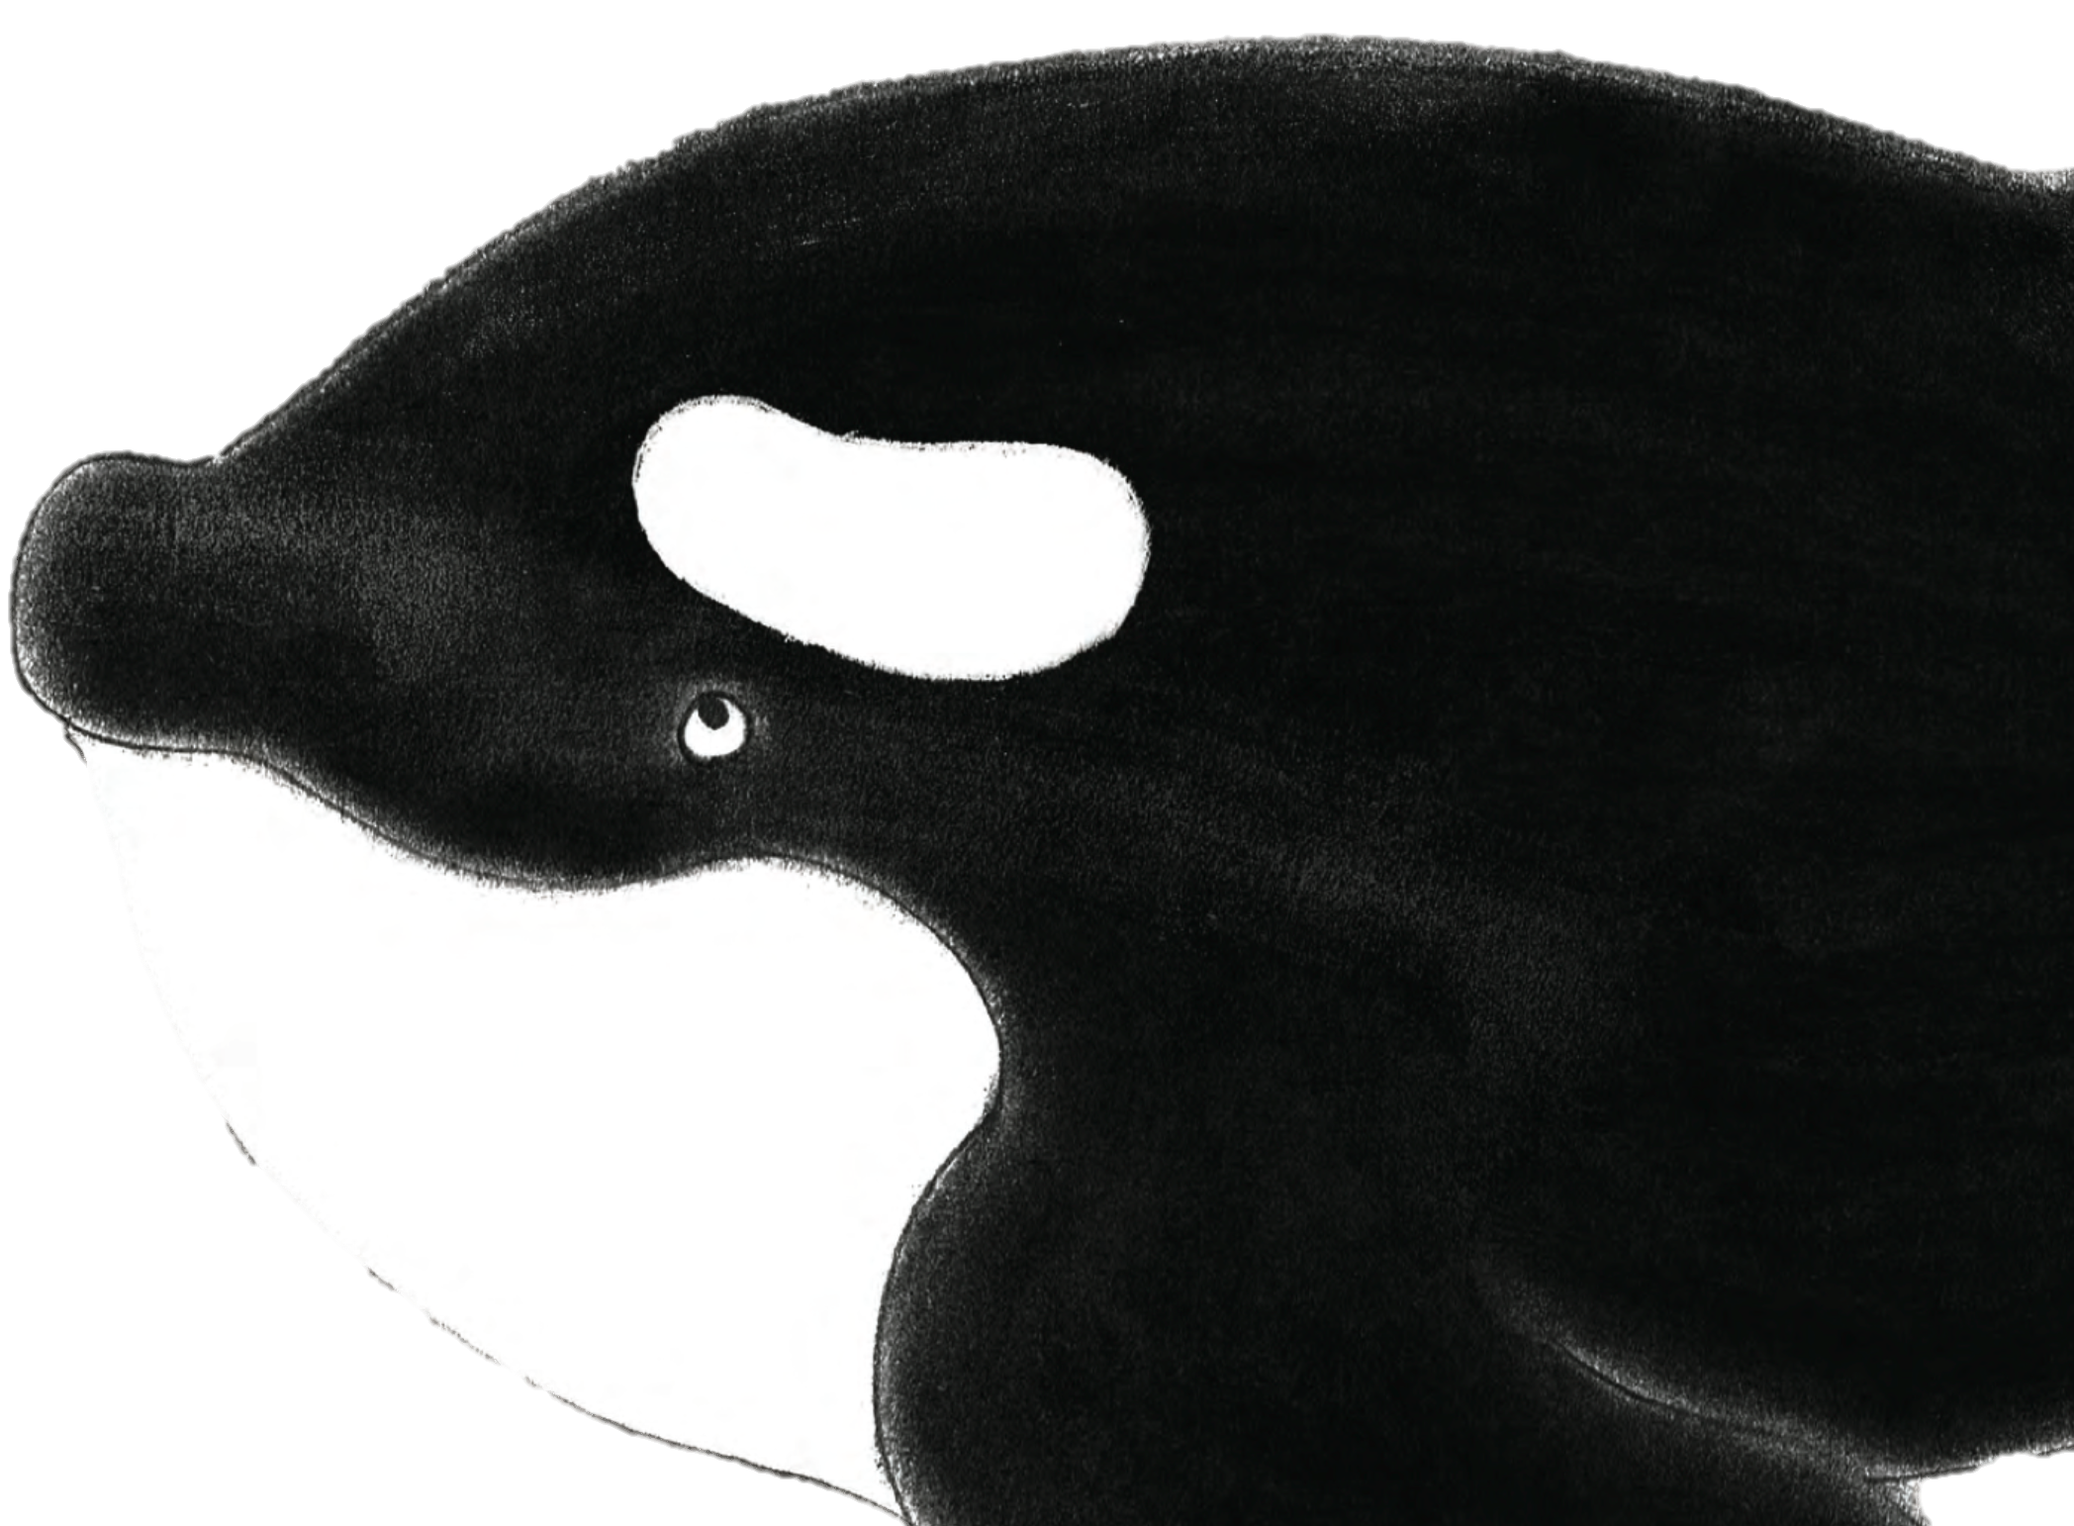
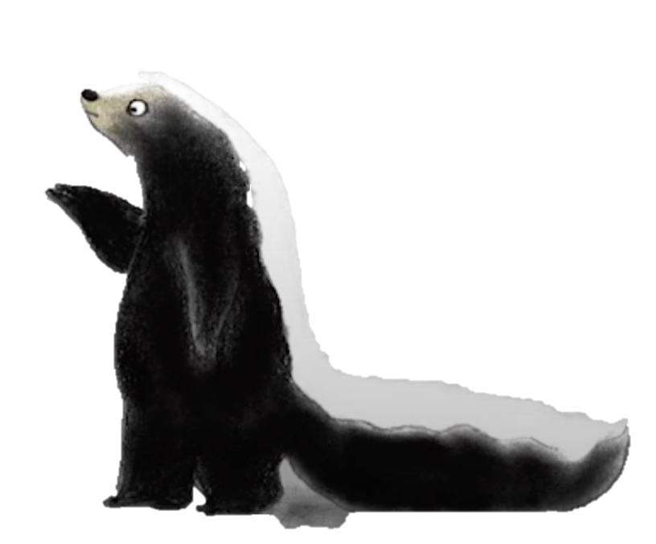
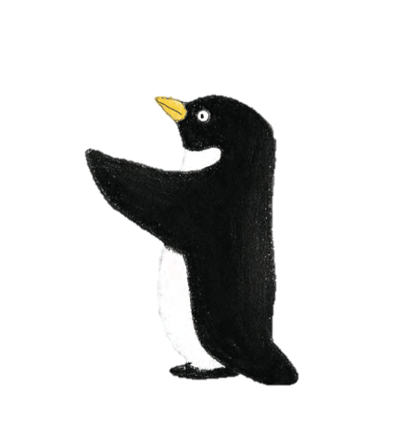
A second ending to the story!
[skunk, ostrich, panda, killer whale, penguin] Antony, S. (2017). Please, Mr. Panda. New York, Cartwheel Books.

Slide 3


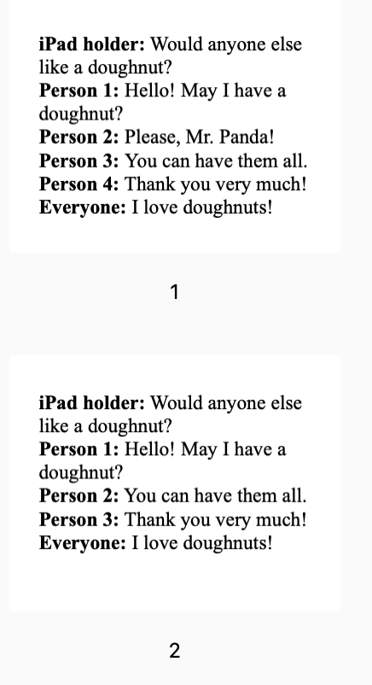

Instructions
Record a video.
Use the script to read out loud.
Save the video.
Notes:
<a href="https://www.freepik.com/free-vector/play-pause-fast-forward-stop-circles_49610157.htm#query=record%20button&position=0&from_view=search&track=ais&uuid=a8803879-722b-44e8-88d7-594318082aab">Image by juicy_fish</a> on Freepik
<a href="https://www.freepik.com/free-vector/digital-device-mockup_4122508.htm#query=tablet&position=1&from_view=search&track=sph&uuid=3f39c555-a79d-4069-8fde-1e9bc272520e">Image by rawpixel.com</a> on Freepik
Image by <a href="https://www.freepik.com/free-vector/flat-design-free-download-label-collection_34709987.htm#query=save%20button&position=3&from_view=search&track=ais&uuid=ddc55ab4-3c42-4fd3-88db-ed36d13139c9">Freepik</a>

Slide 4
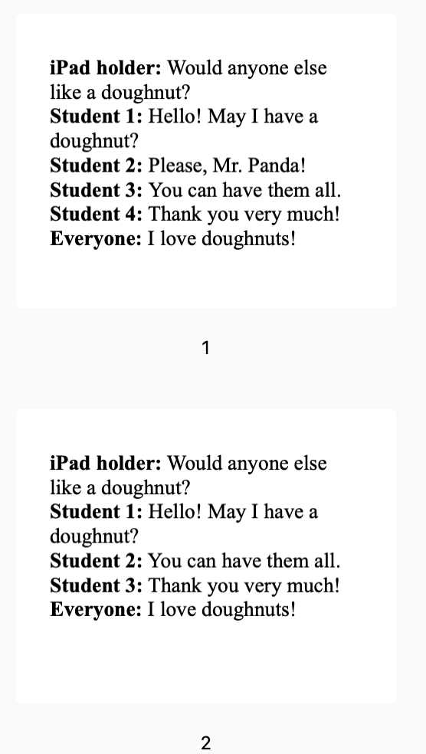
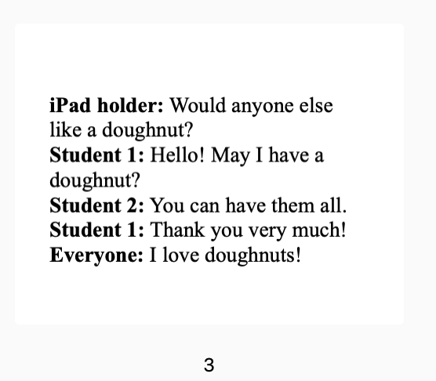
Scripts

Slide 5
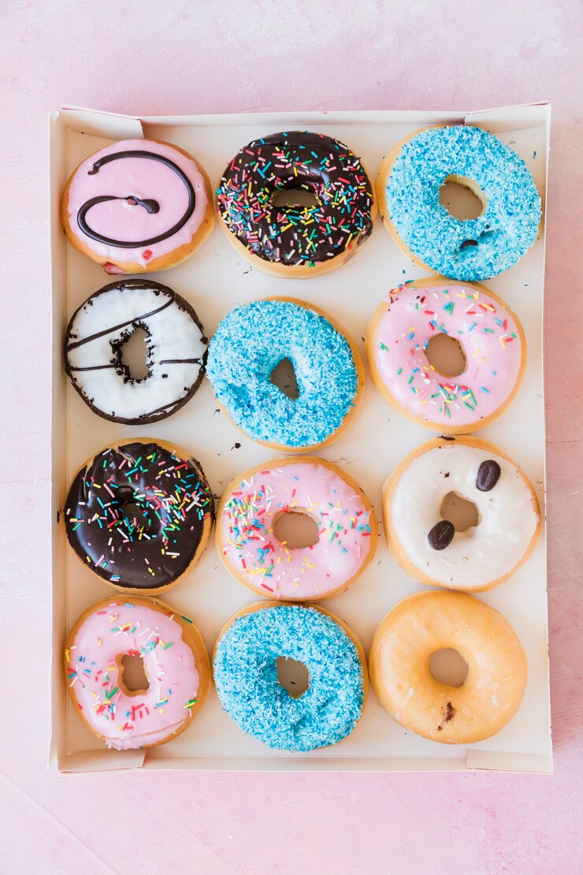
iPad holder: Would anyone else like a doughnut?
Student 1: Hello! May I have a doughnut?
Student 2: Please, Mr. Panda!
Student 3: You can have them all.
Student 4: Thank you very much!
Everyone: I love doughnuts!
Notes:
Image by <a href="https://www.freepik.com/free-photo/row-delicious-donuts-box_3134349.htm#query=box%20of%20doughnuts&position=37&from_view=search&track=ais&uuid=91832e89-c3c6-4717-8d96-9f257ec7ce15">Freepik</a>

Slide 6

Upload videos here!
[penguin] Antony, S. (2017). Please, Mr. Panda. New York, Cartwheel Books.

Slide 7

[skunk, killer whale] Antony, S. (2017). Please, Mr. Panda. New York, Cartwheel Books.
Why is it important to be polite?
“I want the blue one and the yellow one.”
“I want them all! Then bring me some more.”

