Slide 1
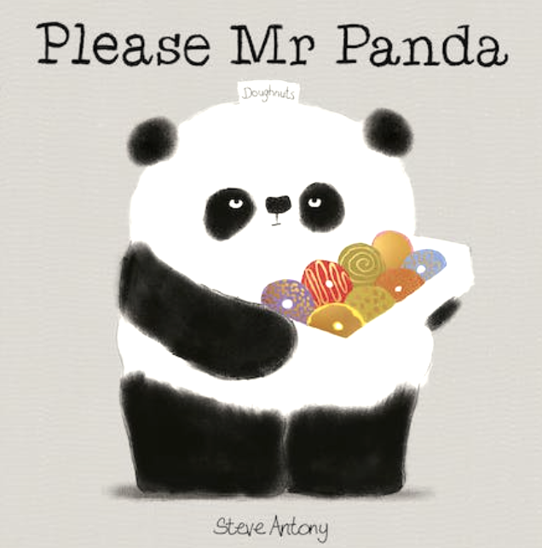
Antony, S. (2017). Please, Mr. Panda. New York, Cartwheel Books.

Slide 2
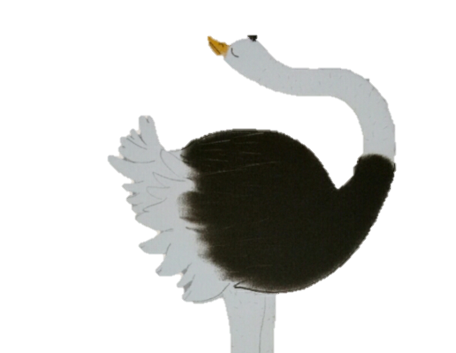
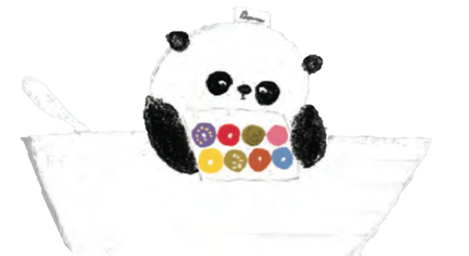
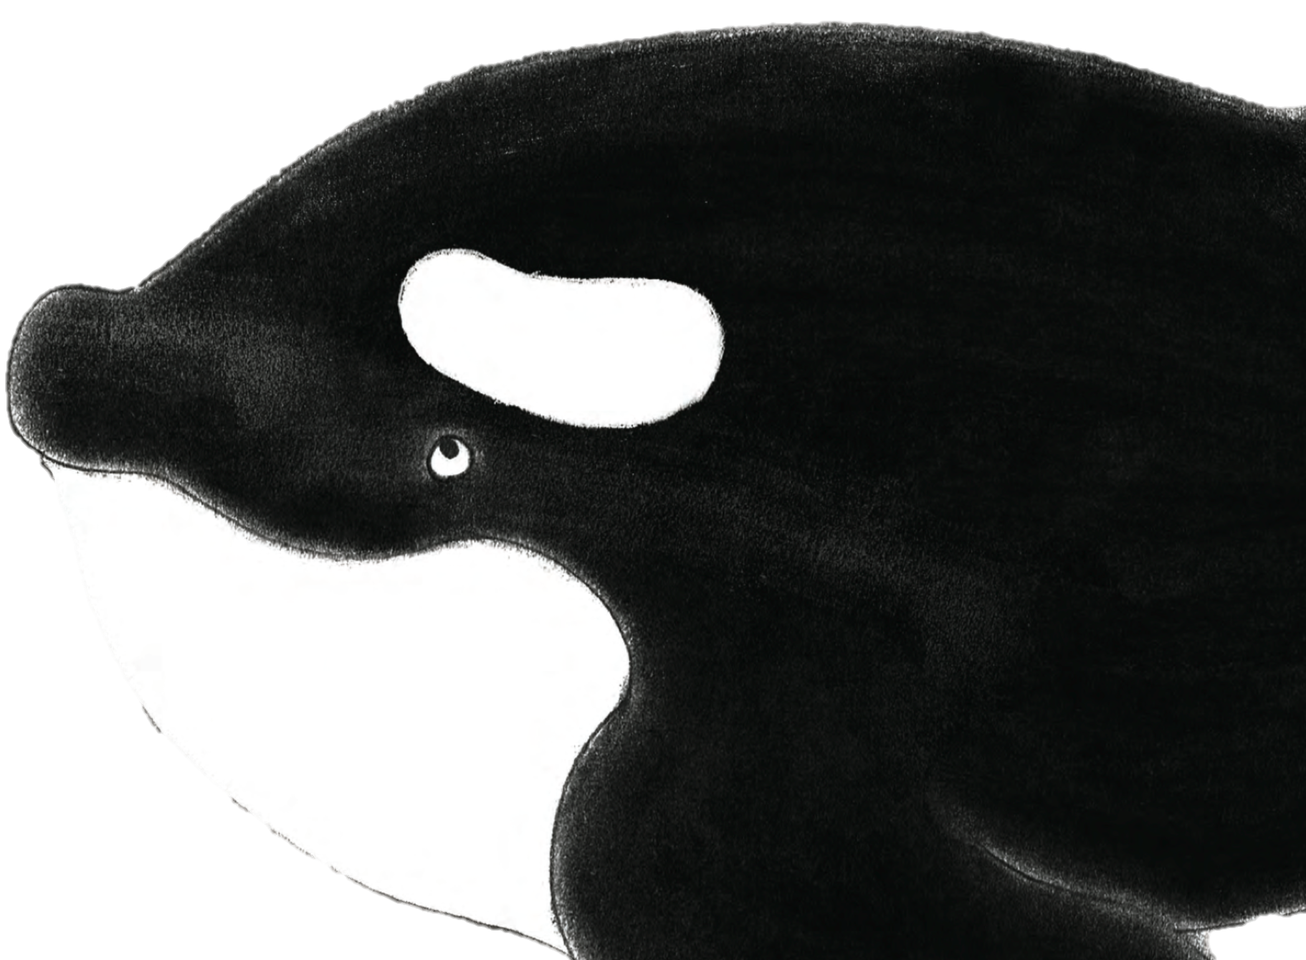
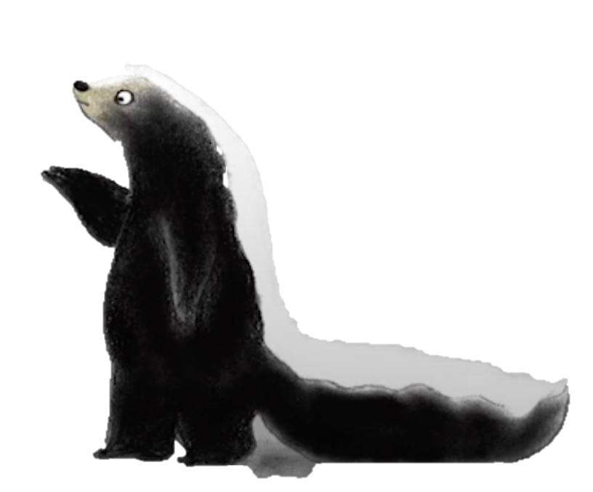
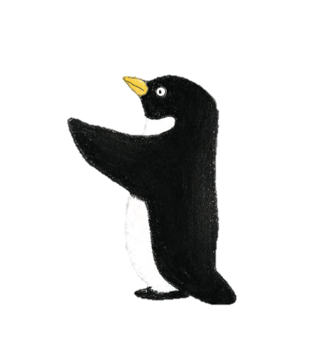
A second ending to the story
[skunk, ostrich, panda, killer whale, penguin] Antony, S. (2017). Please, Mr. Panda. New York, Cartwheel Books.

Slide 3
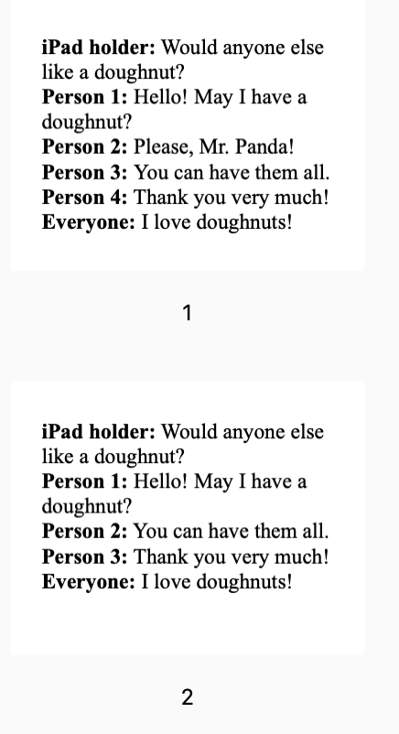
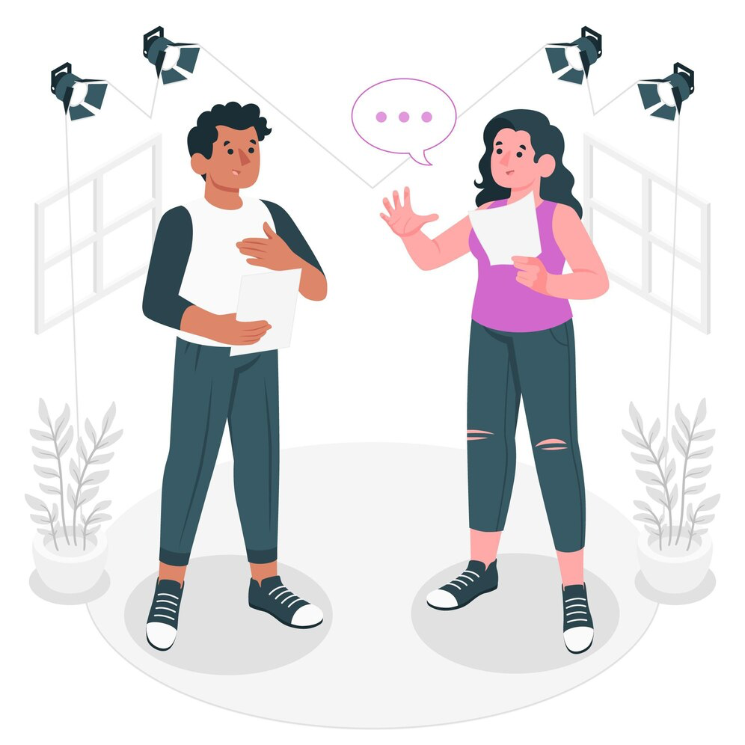
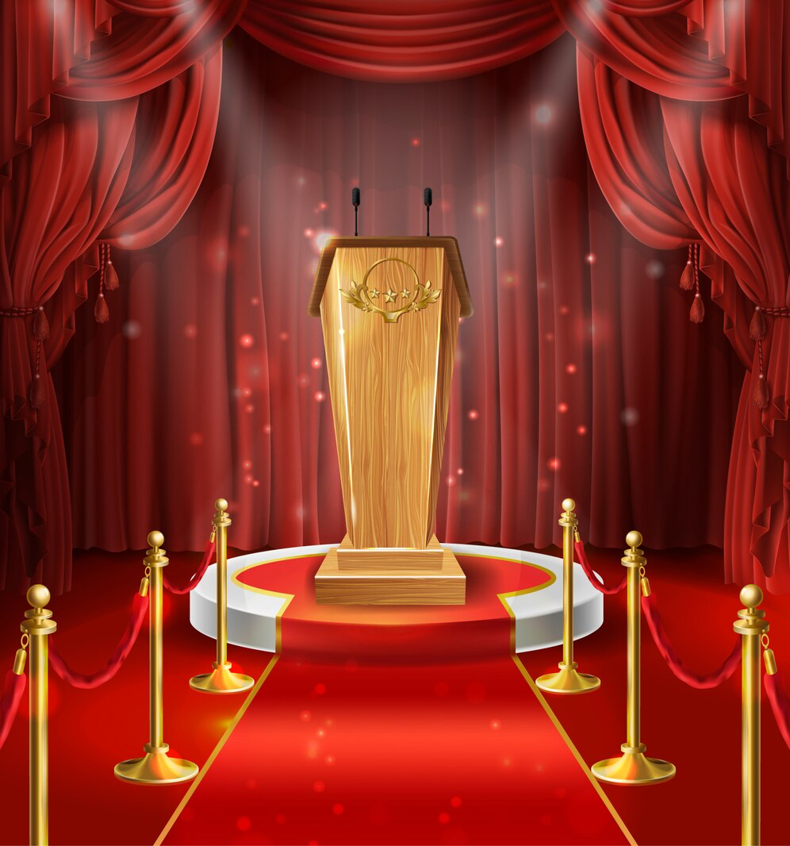
Instructions
Read the script.
Practice it with your group.
Perform it in class.
Notes:
<a href="https://www.freepik.com/free-vector/acting-concept-illustration_15576041.htm#query=act&position=2&from_view=search&track=sph&uuid=8a685bf5-96ec-451d-8657-a230ac572eb7">Image by storyset</a> on Freepik
<a href="https://www.freepik.com/free-vector/illustration-with-wooden-tribune-with-microphones-podium-red-curtains-carpet_2891004.htm#query=perform&position=5&from_view=search&track=sph&uuid=e8ce0f70-cba3-4198-8184-8155c6c28657">Image by vectorpocket</a> on Freepik

Slide 4
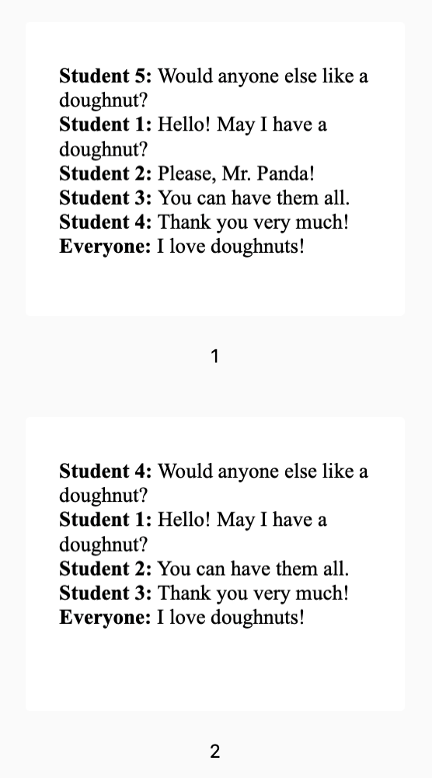
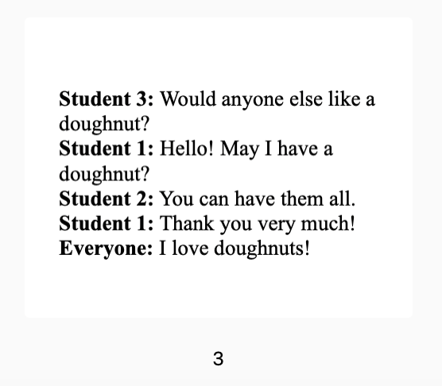
Scripts
Antony, S. (2017). Please, Mr. Panda. New York, Cartwheel Books.

Slide 5
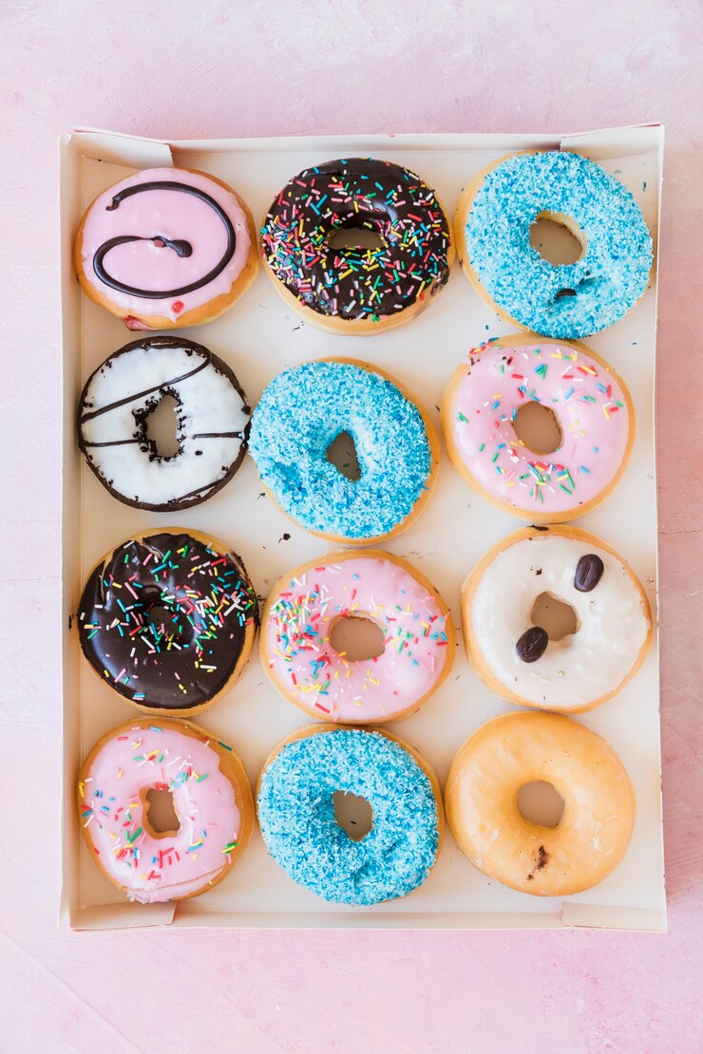
Student 5: Would anyone else like a doughnut?
Student 1: Hello! May I have a doughnut?
Student 2: Please, Mr. Panda!
Student 3: You can have them all.
Student 4: Thank you very much!
Everyone: I love doughnuts!
Antony, S. (2017). Please, Mr. Panda. New York, Cartwheel Books.
Notes:
Image by <a href="https://www.freepik.com/free-photo/row-delicious-donuts-box_3134349.htm#query=box%20of%20doughnuts&position=37&from_view=search&track=ais&uuid=91832e89-c3c6-4717-8d96-9f257ec7ce15">Freepik</a>

Slide 6


Slide 7

Why is it important to be polite?
“I want them all! Then bring me some more.”
“I want the blue one and the yellow one.”
[skunk, killer whale] Antony, S. (2017). Please, Mr. Panda. New York, Cartwheel Books.

