Slide 1
The Components of Classroom Management

Slide 2
The Plan
What is it?
1
How do you encourage students to speak in English?
2
How do you obtain student interest or engagement?
3
How do you control students in the classroom?
4
How do you manage time in the classroom?
5

Slide 3
What is it?

Slide 4
How do you encourage students to speak in English?

Slide 5

Build Bridges
It helps with understanding behavior.
Teach them a conversation to have a conversation.
Notes:
https://www.freepik.com/free-vector/hand-drawn-mumbai-illustration_27519192.htm#fromView=search&page=1&position=23&uuid=c0275547-fb94-40e8-895f-a89e31c1d000

Slide 6

Show Care
Recognize and appreciate each student.
Can encourage motivation.
Notes:
https://www.freepik.com/free-vector/charity-donation-concept-hands-volunteers-holding-giving-heart_11235259.htm#fromView=search&page=1&position=31&uuid=d5e3b2b8-1abb-4d36-88f2-902b421dca21

Slide 7
How do you obtain student interest or engagement?

Slide 8
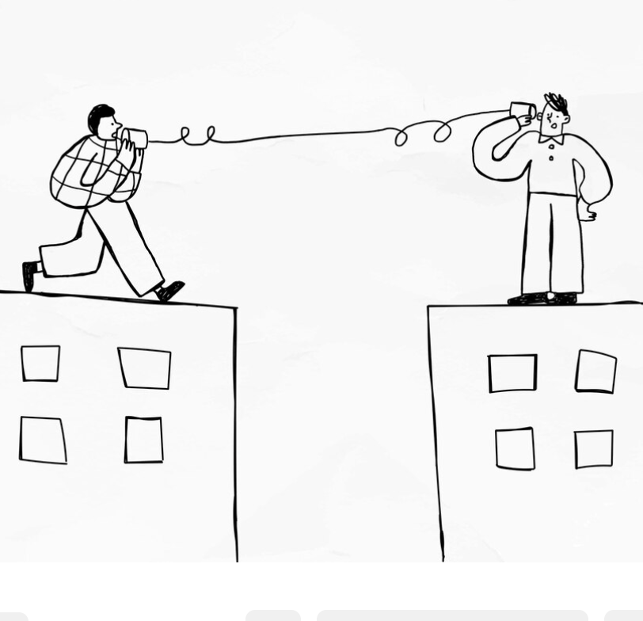
Listen
Create an environment where students feel respected and valued.
Involve students in the decision-making process.
Obtain intriguing information to make lessons.
Notes:
https://www.freepik.com/free-vector/men-talking-with-cup-telephone-while-social-isolation_13313319.htm#fromView=search&page=1&position=4&uuid=f1d36db7-e0b8-49fe-97d5-239d5c917960

Slide 9
How do you control students in the classroom?

Slide 10

Firm and Approachable
Understand the dance between participatory and authoritative methods.
Establish well-defined boundaries.
Notes:
https://www.freepik.com/free-vector/hats-caps-men-women-cartoon-illustrations-set-retro-modern-male-female-headgear-cowboy-summer-straw-hat-isolated-white_20827788.htm#fromView=search&page=1&position=41&uuid=b602222e-25d8-4b4a-9b83-2c6ee6c88ffb

Slide 11
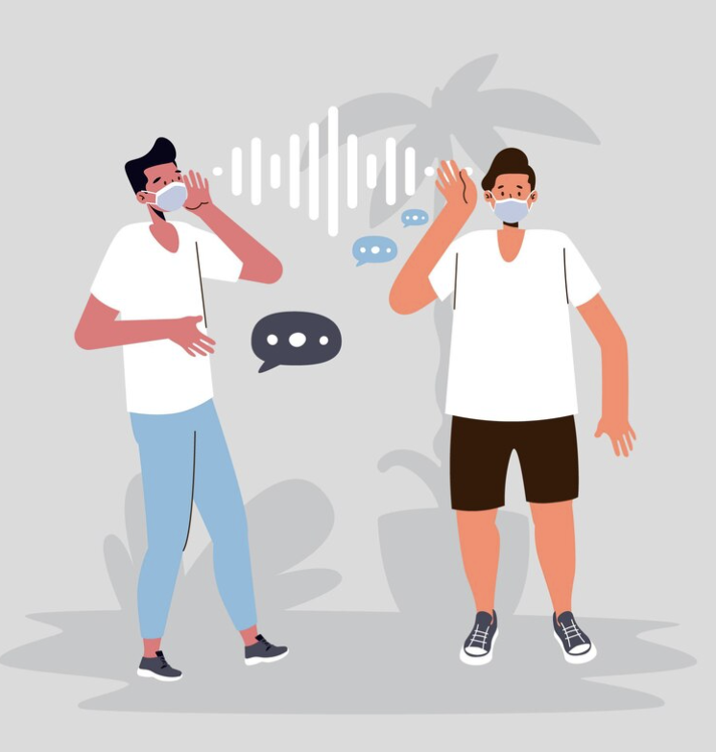
Body Language and Sound
The importance of vocalization.
The importance of silence.
Maintain positive body language.
Model what you want to see.
Notes:
https://www.freepik.com/free-vector/lip-read-problem-due-face-masks_13455023.htm#fromView=search&page=1&position=7&uuid=bed013a8-335c-4e3d-a38b-2b4fccf8dd73

Slide 12
How do you manage time in the classroom?

Slide 13

Time
Chunking for management.
Factor in transition time.
Have a supplemental activity.
Use the board for help.
Use music as an alarm.
Notes:
https://www.freepik.com/free-vector/variety-objects-that-shows-time_5481539.htm#fromView=search&page=1&position=15&uuid=6971ae05-0d5a-478f-8623-a47767a8a8c2

Slide 14
So, to sum it all up...

Slide 15
Encouragement comes from trust.
1
To find interest, just listen.
2
You can't control the class without respect.
3
To manage time, you need to have a plan.
4

